Slide 1


MARKETING STRATEGY OPTIMIZATION ANALYTICS FOR
SPROCKET CENTRAL PTY LTD
Praise Ekeopara
Data Analyst, KPMG Analytics Information & Modelling Team
1

Slide 2
Agenda
Introduction
Data Exploration
Model Development
Interpretation
2

Slide 3
Introduction
Sprocket Central Pty Ltd being a medium sized company that is concerned with bikes and recycling accessories is recently faced with a challenge of optimizing its marketing strategy. A sound data driven assistance resolves this.
The following key objectives serve as a solution to the above problem as target customers are identified and segmented;
Targeting high value customers based on customer demographics and attributes
To reveal useful customer insights which will help optimize resource allocation for the targeted customers
To recommend which of these 1000 new customers should be targeted to drive the most value for the organization.
This analytics reveals wonderful customer insights which could help optimize resource allocation for targeted marketing. The company therefore improves performance by focusing on this high value customers.
3

Slide 4
Data Exploration
Data Exploration is simply a process of exploring and understanding the data in details. This can be done with the use of descriptive statistics, plots, charts, and visualizations to look at various data attributes, finding associations and correlations and making a note of the data quality problems if any.
The following steps are to be taken in discovering useful insights from our data;
Explore, describe, and visualize data attributes.
Select data and attributes subsets that seem most import for the problem
Extensive analysis to find correlations and associations.
Note missing data points if any.
These steps as carefully followed reveals useful insights from our data. This useful insights guides in targeting high value customers by customer segmentation.
4

Slide 5
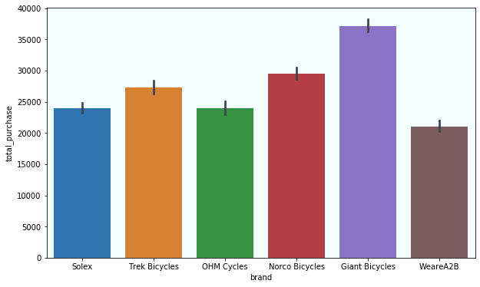
Data Exploration – Customer Purchase by Brand
Total Purchase by Brand
From the analysis, the highest purchased company’s goods by brand is the Giant Bicycles with a total purchase of above $35,000.
This implies that our target customers are mostly to purchase this brand of product.
5

Slide 6
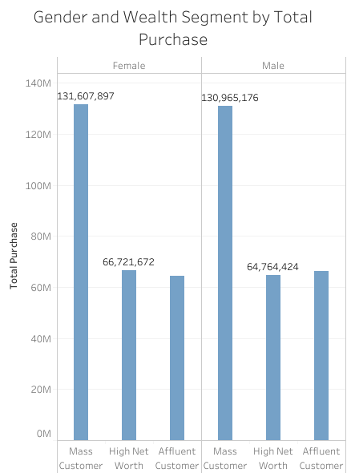
Data Exploration – Customer Purchase by wealth Segment & Gender
With total purchases of $131,607,897 and $130,965,176 shows that our customers are both females and males.
By Wealth Segment analysis, highest purchases are made by the Mass Customer class.
Higher purchases are made by females with few exceptions under the wealth segment customer attribute.
6

Slide 7
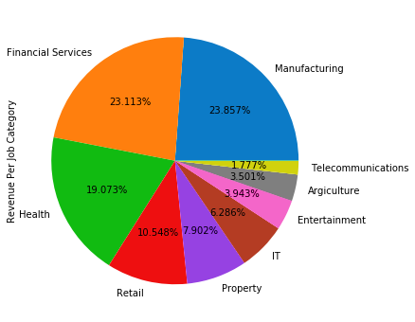
Data Exploration – Customer Purchase by Job Category
Total Purchase rate by Job Category
Based on the Job category of customers, our customers are majorly located in Manufacturing and Financial Services with rates of 23.857% and 23.113% respectively.
This indicates that our target customers are likely to be located from the above sectors.
7

Slide 8
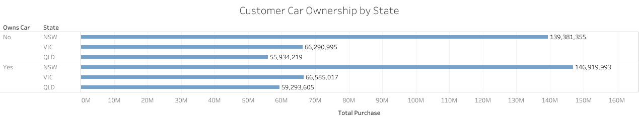
Data Exploration – Customer Purchase by State & Car Ownership
Clearly observing, the highest purchasing customers are from North South Wales (NSW) state in Australia.
Most of our customers are car owners. And they have the highest rate of purchase across all states in Australia.
8

Slide 9
Model Development
Having 1000 new customers, there is need to build a recommendation engine that can accurately predict or suggest high revenue generating customers from amongst this. This is useful as it will help in proper resource allocation for the company. This is where machine learning comes into play.
Decision Tree Algorithm
This is a machine learning classifying algorithm used in decision analysis. This algorithm is fed with historical dataset of the company and hence identifies patterns from them so as to develop a predictive model. This model is now used to recommend target customers from this new 1000 customers.
9

Slide 10
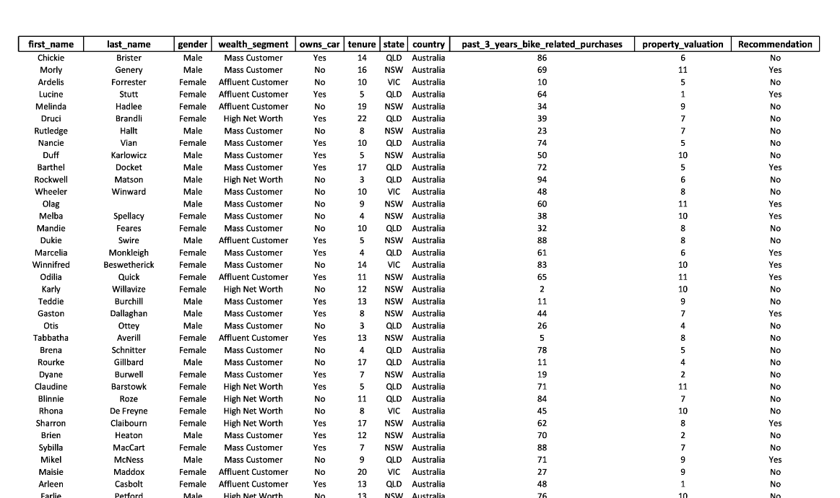
Model Result
10

Slide 11
Interpretation
High value generating customers are male and female individuals that are within the age range of 18 to 65. Those purchasing at a higher rate are predominantly located at NSW in Australia and mostly fall under the Manufacturing and Financial Services job category with rates of 23.857% and 23.113% respectively.
However, with a wealth segment of Mass Customer category, these high value generating customers purchase majorly the Giant Bicycles followed by Norco Bicycles.
Recommendation
By applying flexibility in data scaling, feature engineering, feature selection, ensemble learning and adjusting of hyper-parameters will go a long way in modifying the accuracy and performance of the data.
11

Slide 12
Thank You !
12

